Slide 1
Image Out painting using GANS
Team BTS-
Bharath Gunasekaran
Tamanna Mehta
Stuti Agarwal

Slide 2
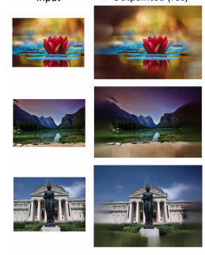
Introduction
Image Out-painting is a computer vision problem and involves restoring the missing portions within an image.
While doing image out-painting the neighboring information is required to complete the image
Out- painting has applications in wide range of areas like panorama creation, texture creation and vertically filmed video expansion.

Slide 3
Introduction (contd..)
We have developed a model using Generative Adversarial Networks that implements image out - painting on the basis of the neighboring information.
We used DCGAN architecture to implement our model .

Slide 4
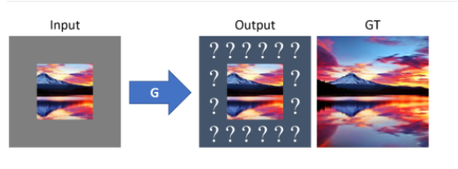
Dataset
Places 365 dataset(diverse set of landscapes, buildings, rooms, and other scenes from everyday life)
Input : Images resized from 256*256 to (128*128) to speed up training
Masking done and removed the boundaries of the image
Output: out-painted Images of size (128*128)
Training dataset-500 images
Validation dataset-100 images
Epochs-
for generator-200
for discriminator-150
for GANS-220

Slide 5
Model Explanation
DCGAN has -
Generator
Discriminator with convolutional layers
We train Generator with masked images and calculated loss is MSE.
Discriminator gets real images and fake images as input and tries to distinguish which images are fake or real.
Generator generates fake image and labels it as 1 to fool the discriminator.

Slide 6
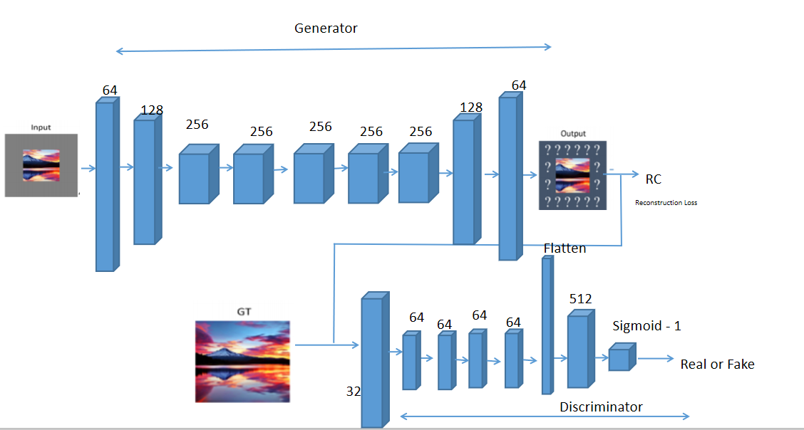
Model Architecture

Slide 7
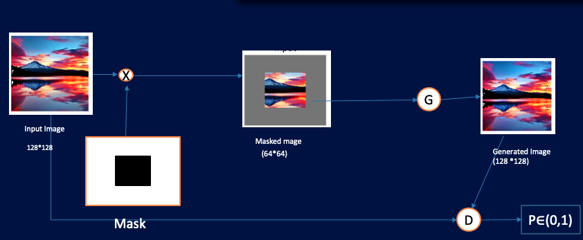
Training Pipeline

Slide 8
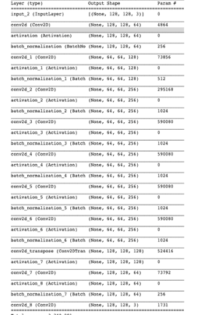
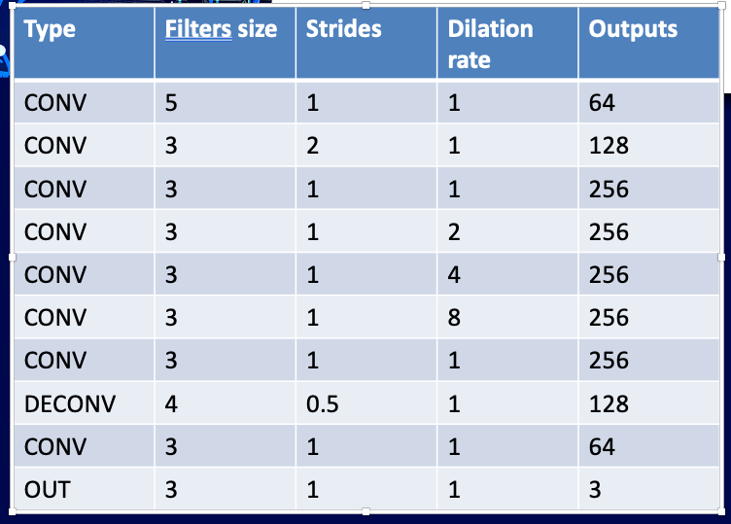
Generator Layer Architecture and Summary

Slide 9
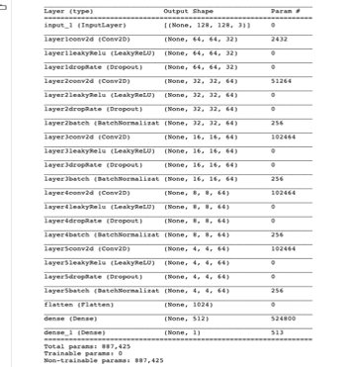
Discriminator Layer Architecture and Summary
Type | Filters size | Strides | Outputs
CONV | 5 | 2 | 32
CONV | 5 | 2 | 64
CONV | 5 | 2 | 64
CONV | 5 | 2 | 64
CONV | 5 | 2 | 64
FC | - | - | 512
FC(output) | - | - | 1

Slide 10
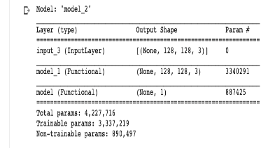
Model Summary for GAN

Slide 11
Significance of Dilated Convolutions
We tuned the architecture by changing the dilation rate in our generator ranging from 2,4,8 for the dilated convolution layers of the generator.
By taking different dilation rates it becomes easy for the network to reconstruct the images and increase the receptive field of neurons and improve realism.

Slide 12
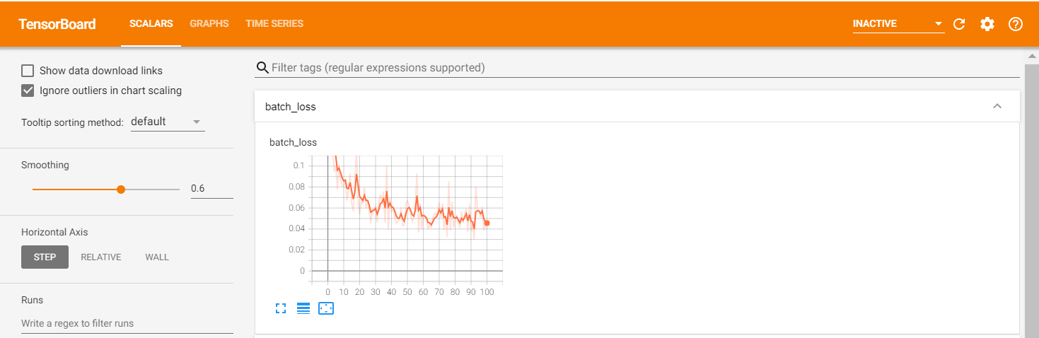
Tensor Board showing batch loss

Slide 13
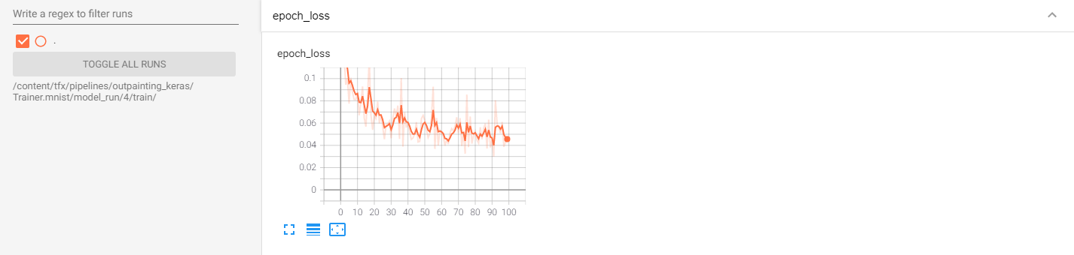
Tensor Board showing epoch loss

Slide 14
Hurdles in the development
Our model is a GAN model having three subsequent models namely, Generator , discriminator and GAN itself . So the input and the loss variation and calculation was tricky
As compared to other image classification works, our model has an image as our label rather than an integer which makes it very unique and difficult to implement.
While implementing our tfx pipeline we had to work in the trainer component with three models and multiple inputs . Again the label is an image rather than an integer.

Slide 15
Demo!

Slide 16
Team Contribution
Team Member | Contribution
Bharath Gunasekaran | Modelling, Data Preparation, Data processing, Tfx pipeline, Flask Application,Deployment via Kubeflow
Stuti Agarwal | Modelling, Data processing, Tfx pipeline, Flask Application,Deployment, Kubeflow pipeline
Tamanna Mehta | Research, Modelling, Data Preparation, Data processing, Tfx pipeline,Deployment

Slide 17
Research References
Painting Outside the Box: Image Outpainting with GANs by Mark Sabini and Gili Rusak Stanford University {msabini, gilir}@cs.stanford.edu
https://arxiv.org/pdf/1808.08483.pdf
Image Outpainting and Harmonization using Generative Adversarial Networks by Basile Van Hoorick Columbia University
https://arxiv.org/pdf/1912.10960.pdf
tfx pipeline referenced from : https://github.com/tensorflow/tfx/blob/master/tfx/examples/mnist/mnist_pipeline_native_keras.py

